Slide 1
Class 2DE/2DI Group G055 SPRINT 2
Group members:
Hanna Järveläinen (1220415)
Daniel Krzykawski (1220390)
Minju Lee (1220450)
Sirkku Kilpinen (1220472)
Andrzej Handzlik (1220375)
Christina Hardeland (1220385

Slide 2
Sprint planning – Sprint 2
Planned Start Date: 5.12.2022 Real Start Date: 5.12.2022
Planned Finished Date: 8.1.2023 Real Finish Date: 8.1.2023
SPRINT BACKLOG
Number of stories | 8
Number of bugs | 0
Number of tasks | 10
Number of Management Tasks | 10
Number of team members | Planned: 6 Actual: 6
Total planned estimation vs execution | Planned hours: 95 Executed hours:100

Slide 3
Sprint planning
Assignment US | Commited? | Todo | Doing | Testing | Done | Blocked
US 210 |  |  |  |  | x
US 211 |  |  |  |  | x
US 212 |  |  |  |  | x
US 213 |  |  |  |  | x
US 214 |  |  |  |  | x
US 215 |  |  |  |  | x
US 216 |  |  |  |  | x
Update data model |  |  |  |  | x

Slide 4
Sprint Execution
Issues | Sprint Backlog (a) | Added issues during sprint (b) | Closed issues from initial planning (c) | Closed issues from added ones (d) | Issues not closed (e) | % Execution
 |  |  |  |  |  | Planned (c/a) | Total (c+d)/(a+b)
Number of stories (I) | 6 | 2 | 6 | 2 | 0 | 100% | 100%
Number of bugs (II) | 0 | 0 | 0 | 0 | 0 | N/A | N/A
Number of tasks (III) | 0 | 10 | 0 | 10 | 0 | N/A | 100%
TOTAL | 6 | 12 | 6 | 12 | 0 | 100% | 100%
Total Estimate | 95 h

Slide 5
Work by team member

Slide 6
Work by type

Slide 7
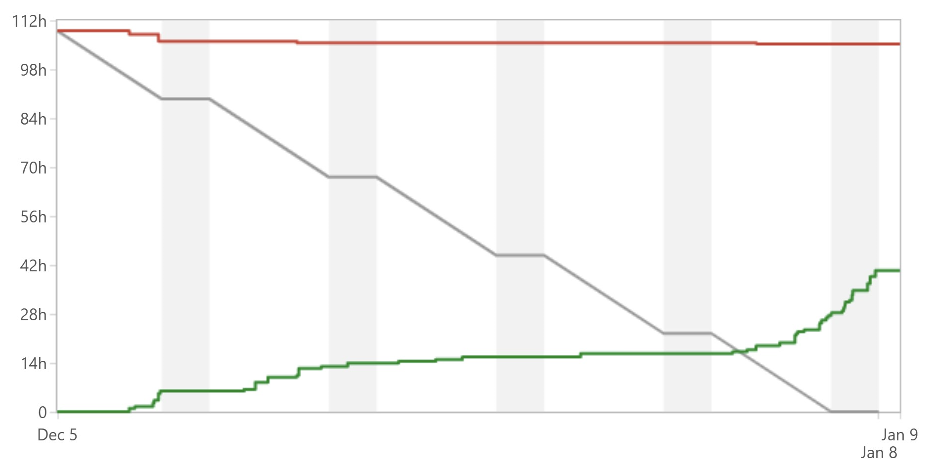
Sprint Burndown Chart
Note: The students participating in the project but not to LAPR3 course didn’t record the hours, so the burndown chart is not realistic. The hours were logged to the subtasks but the hour estimates were made for the user stories, this might also affect the chart?
Print do JIRA após fecho da sprint

Slide 8
Sprint Review
Date: 8.1.2023
Main conclusions:
Most of the user stories full fill the requirements
User stories have tests
The functionalities of the user stories are documented

Slide 9
Sprint Retrospective
Date: 8.1.2023
What went well?
We managed to communicate with the client (the teacher) to clarify the requirements
Most of the work was started early, so it was possible to ask more questions from the client during working
We defined the definitions of done better
We organized better our repository which made the work easier
What went wrong?
Most of the user stories were not peer reviewed
Lack of communication
Holidays and team members traveling made it more difficult to manage this Sprint and arrange Daily Scrums
Jira not working made it difficult to track the process sometimes
What we’ve learned?
There will always be new questions after you start working on the task
Documenting the work is important and very often underestimated
Communication is important

Slide 10
Sprint Retrospective
Date: 8.1.2023
Action items:
We will peer review the US
We will inform the team when a task is ready to be reviewed
We will communicate better

Slide 11
Team performance metrics

